Slide 1
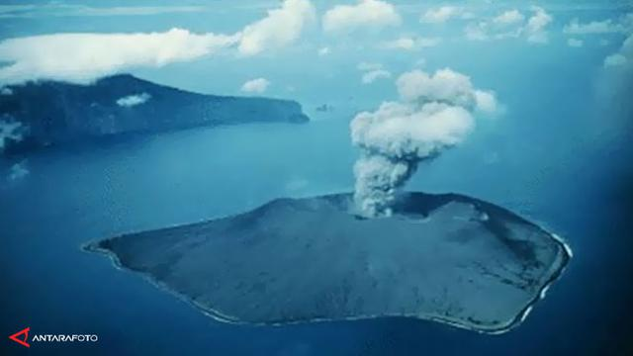


Chengdu, 26 June 2019
Himawari-8 Observation of Significant Krakatau Eruption
on December 2018
Tyas Tri Pujiastuti, Bony Septian Panjaitan, Sugeng Indarto, Asri Susilawati
Remote Sensing Data Management Division
Agency for Meteorology, Climatology, and Geophysics (BMKG)
Indonesia

Slide 2

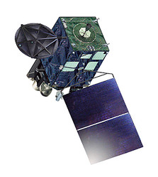
Outline
Background – Whats with Krakatau on December 2018
Data & Methods
What to expect
What we choose to use
Why RGB
Results
Ash detection
SO2 detection
Volcanic CB microphysics
Conclusion
CSPP Users’ Group meeting, 2019

Slide 3
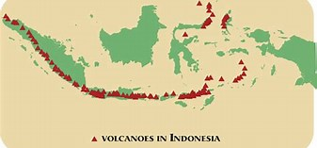
Background
Indonesia archipelago has 76 active volcanoes,
Two of the most devastating volcanic eruptions in historic time took place in Indonesia: 1. the enormous eruption of Tambora in 1815, and 2. the disastrous eruption of Krakatau in 1883.
Volcanic activity monitoring is critical in national disaster risk reduction.
CSPP Users’ Group meeting, 2019

Slide 4
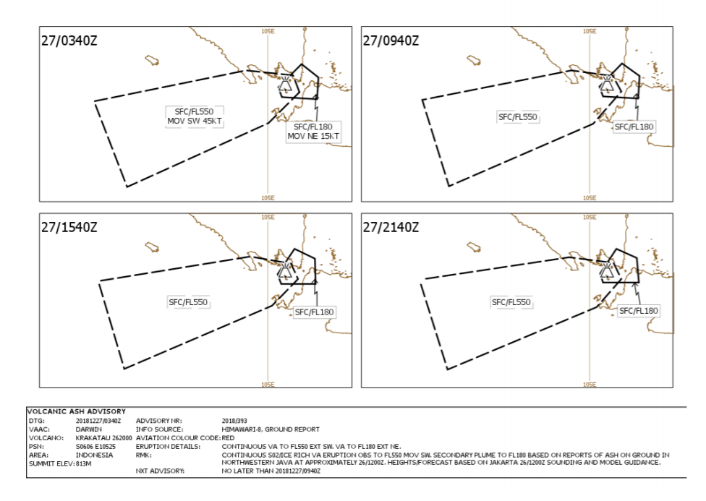
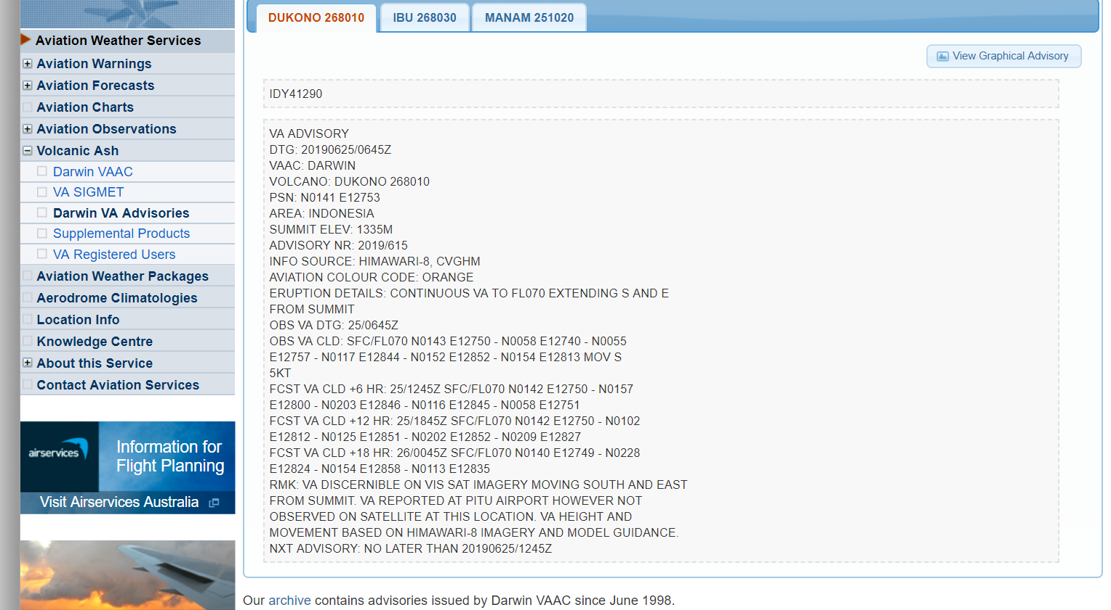
Background
BoM Australia, as VAAC routinely provided VA advisories (its observation and forecast) in text and graphical format.
CSPP Users’ Group meeting, 2019

Slide 5
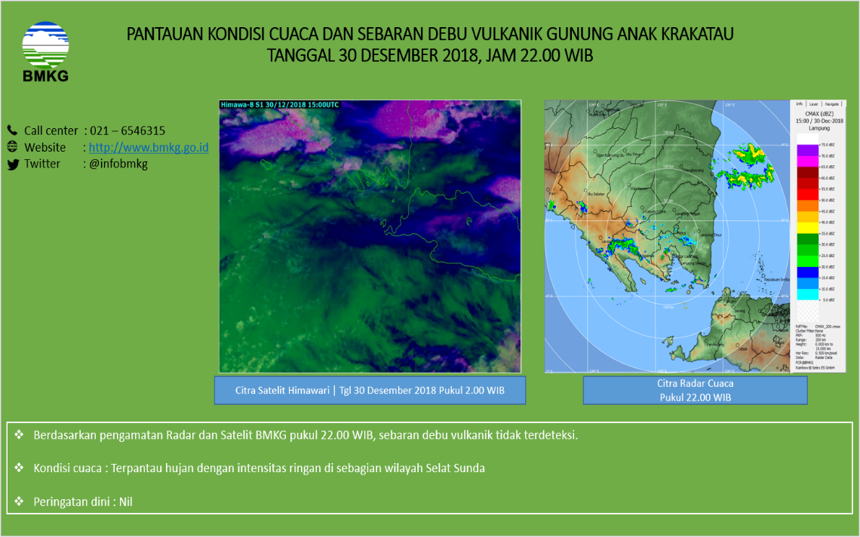
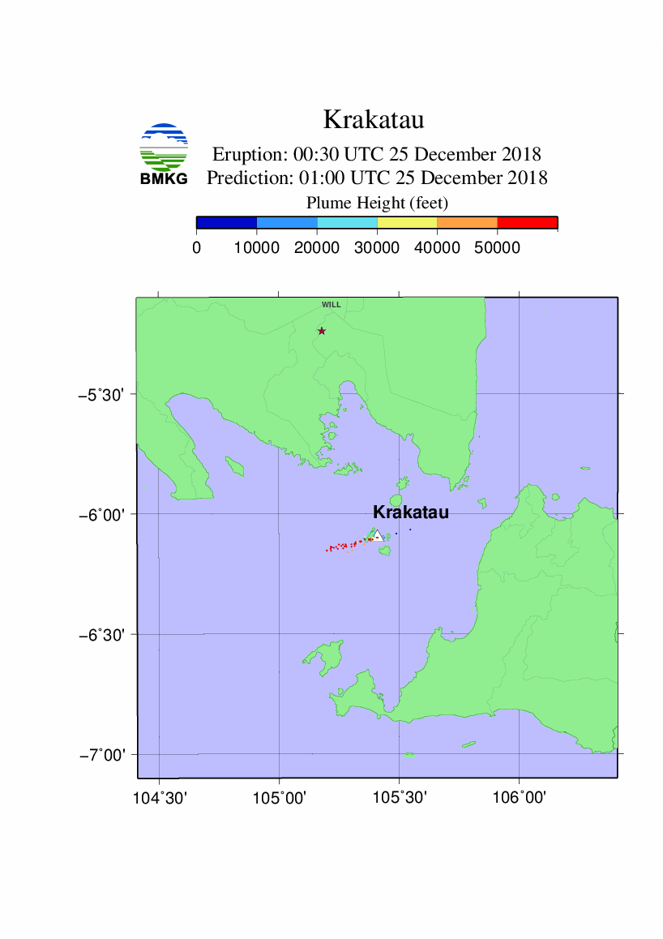
Background
What BMKG do:
realtime monitoring from satellite (Himawari-8) and Radar (C band) of volcanic ash dispersion and height.
Prediction of volcanic ash dispersion and height using PUFF model
CSPP Users’ Group meeting, 2019

Slide 6
Background
Krakatau Eruption on 22 Dec 2018 13.10 UTC, trigerred landslide, massive wave, and tsunami in Pangandaran coast (54 km from the mountain), 437 died, 14.059 injured, 16 lost, 33.721 evacuated . Sustained activity of the volcano dispersed volcanic ash and SO2 that affect air traffic, human health, and marine transportation.
The eruption destroy all in-situ instruments around the mountain. Visual observation can only be conducted from (the island) about 50 km from the mountain.
Relying on remote sensing, there is necessity of continuous, efficient, and reliable information of eruption impacts (ash, SO2)
Himawari -8 with 16 channels spectral wide offers possibility of various informations, 10-min of temporal resolution fulfill the need for realtime monitoring.
CSPP Users’ Group meeting, 2019

Slide 7
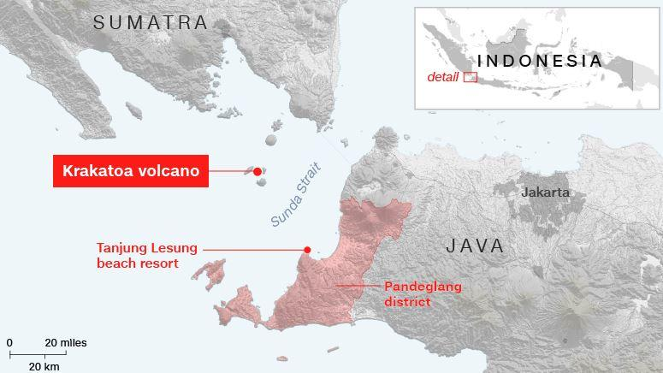
Observation Challenges
Remote observation challenges:
- Occurred during wet season (much cloud obscurration)
- Marine environment surrounded the mountain (From Tupper et al 2019, sea-water interaction must have influence to the eruption plume height)
CSPP Users’ Group meeting, 2019

Slide 8
Eruption Chronology Entries
volcanic cloud observed, with Lightning.
volcanic cloud decreased.
volcanic activity decreased.
CSPP Users’ Group meeting, 2019

Slide 9
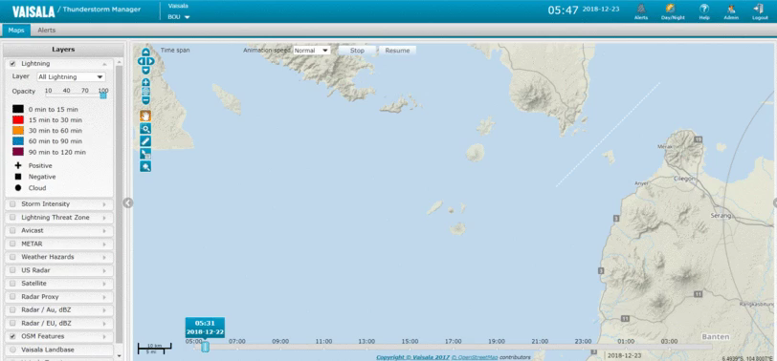
Rough counts have had peak values of 90 lightning events per minute detected around the volcano
CSPP Users’ Group meeting, 2019

Slide 10
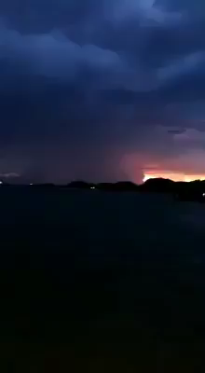
Data & Methods
What to expect:
Volcanic Ash dispersion (very little chance. if any, in high altitude)
SO2 dispersion (if any, in high altitude)
Volcanic CB (its microphysics and character)
What we use : various RGB schemes
Ash ‘bmkg’ RGB, Ash RGB (volcanic ash dispersion)
SO2 RGB, airmass RGB (SO2 dispersion)
Cloud Microphysics RGB.
Video of Krakatau 27 Dec 2018
CSPP Users’ Group meeting, 2019

Slide 11
Why RGB
Name | Principle | Reference
Reverse Absorption | 2-band IR (11 and 12 um) | Prata (1989)
Ratio | 2-band IR (11 and 12 um) | Holasek and Rose (1991)
4-Band | IR + Visible | Mosher (2000)
TVAP | 3-band IR (3.9, 11 and 12 um) | Ellrod et al. (2003)
Principle Component method | Multi-band principal components | Hillger and Clark (2002)
Water Vapor Correction method | 2-band IR + water vapor correction | Yu et al. (2002)
Robust AVHRR Technique | 3-band IR (3.5, 11 and 12 um) | Pergola et al. (2004)
RAT (Ratio of R3.75 to R0.65) | 2-band reflectance (0.65 and 3.75 um) | Pavolonis et al. (2006)
3-Band | 3-band (IR + Visible) | Pavolonis et al. (2006)
RGB | Multi-band, optimal interpretation | Many
CSPP Users’ Group meeting, 2019

Slide 12
Why RGB
RGB Advantages:
Easily implemented
Millions of colours: high information content
Relatively easy to interpret
Preserves temporal continuity allowing for smooth animation of RGB image sequences
Reverse absorption Technique drawbacks:
BT(10.8) - BT(12.0) can be negative by other reasons
Very thick ash clouds sometimes have positive BT(10.8) - BT(12.0)
Ash cloud with very high amount of water vapor can have positive BT(10.8) - BT(12.0)
CSPP Users’ Group meeting, 2019

Slide 13
Volcanic Ash Detection
‘BMKG’ Ash RGB scheme
Ash RGB scheme
Red | IR10.8-IR12.0
Green | IR3.9-IR10.8
Blue | IR3.9
Red | IR12.0-IR10.8
Green | IR10.8-IR8.7 (rev)
Blue | IR10.8 (rev)
Convective cloud
Cold, thick, high-level clouds
Volcanic Ash
Thin cirrus clouds, contrails
Volcanic SO2 clouds
Volcanic ash clouds
CSPP Users’ Group meeting, 2019

Slide 14
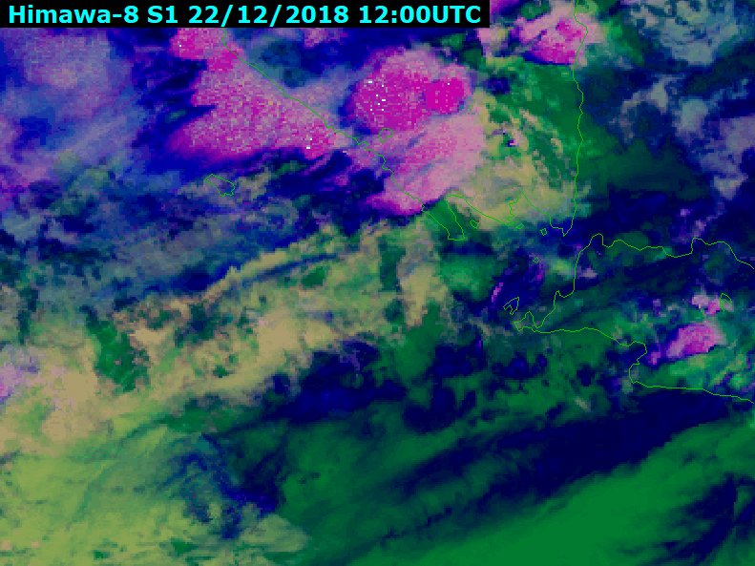
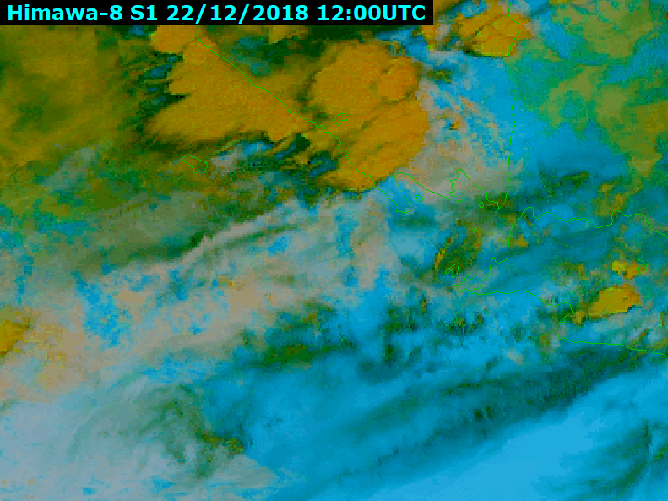
Volcanic Ash Detection
22 Dec 2018 (12 – 21 UTC): the eruption first began around 13.10 UTC. Cloudy condition around the mountain.
CSPP Users’ Group meeting, 2019

Slide 15
Volcanic Ash Detection
From two RGBs:
There were no VA detected on both RGB. Instead, there were continuous convective cloud from the mountain during the eruption.
Ground manual observation data said the eruption began on 13.10 UTC. From satellite data (showed on ‘BMKG’ ash RGB), there low cloud that constantly spread eastern until 14.20 UTC.
SO2 deployed from the eruption, observed in ash RGB (bright green) on northern direction and some were southwestern direction. Strange eastward low cloud not observed.
CSPP Users’ Group meeting, 2019

Slide 16
SO2 Detection
SO2 RGB scheme
Airmass RGB scheme
Red | WV6.9-WV7.3 (rev)
Green | IR10.8-IR8.7 (rev)
Blue | IR10.8 (rev)
Red | WV7.3-WV6.2
Green | IR10.8-IR9.6
Blue | WV6.2
Volcanic gas (SO2>water vapor)
Thick, high-level clouds
Volcanic gas (SO2<water vapor)
Thick, mid-level clouds
Warm airmass (high humidity at upper tropopause)
Cold airmass
Warm airmass (low humidity at upper tropopause)
CSPP Users’ Group meeting, 2019

Slide 17
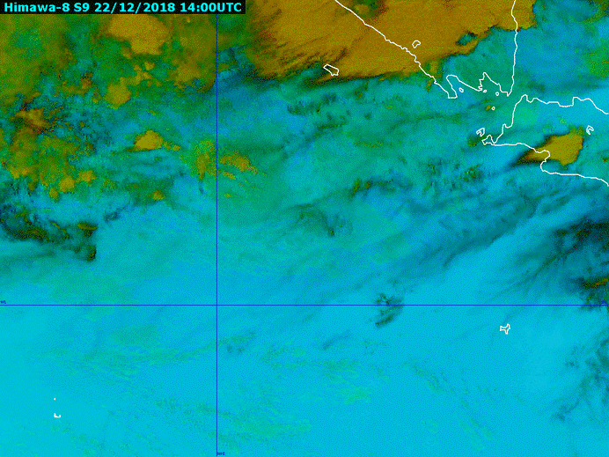
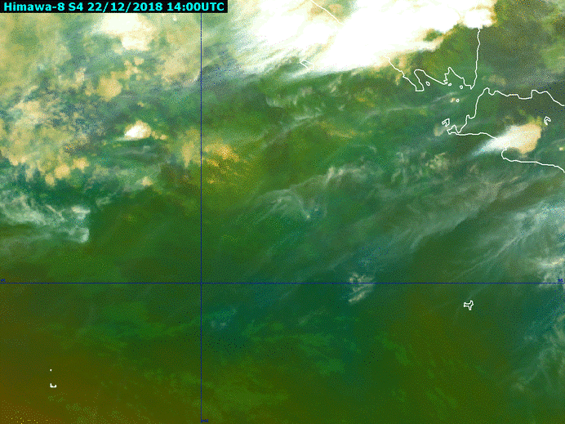

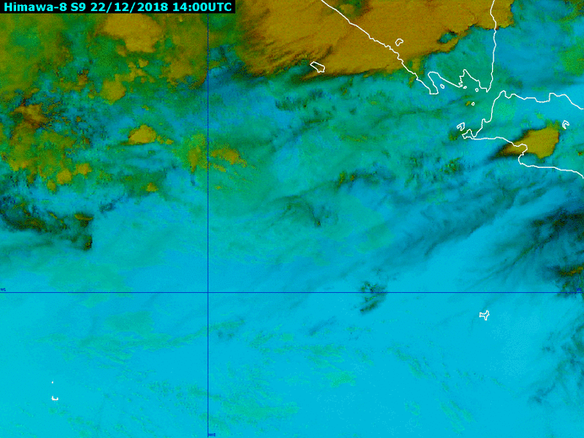
SO2 Detection
22 Dec 2018 (13 – 23 UTC): the eruption first began around 13.10 UTC. Cloudy condition around the mountain
CSPP Users’ Group meeting, 2019

Slide 18
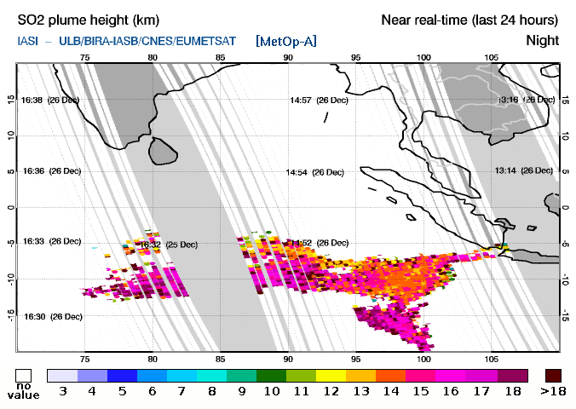
SO2 Detection
From two RGBs:
SO2 RGB is able to show SO2 dispersion more distinct, even when it mixed with convective cloud which has high watervapor.
Airmass RGB is also able to show SO2 dispersion, but it fail to emerge when it mixed with thick cloud.
Both generally consistent to IASI measurement
CSPP Users’ Group meeting, 2019

Slide 19
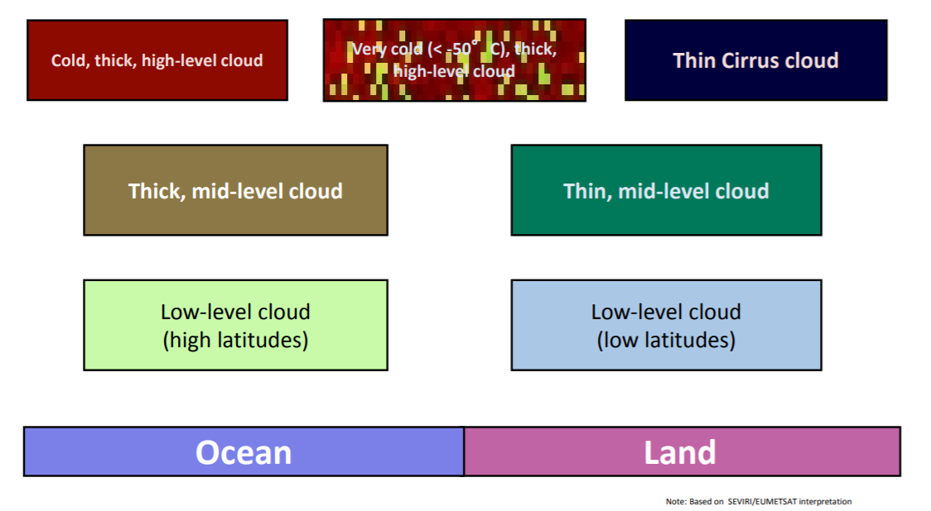
Volcanic CB Detection
Night Mycrophysics RGB scheme
Red | IR12.0-IR10.8
Green | IR3.9-IR10.8
Blue | IR10.8 (rev)
CSPP Users’ Group meeting, 2019

Slide 20
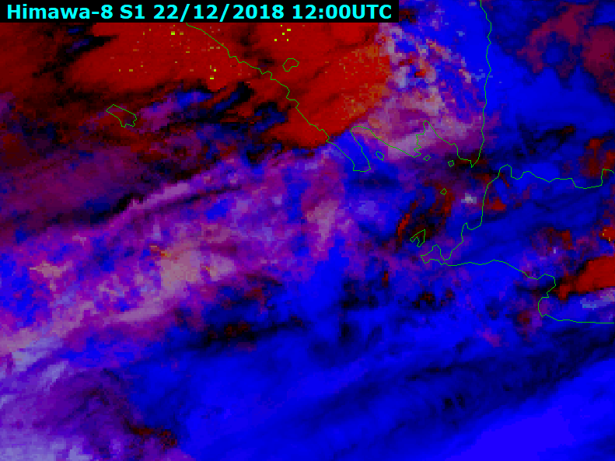
Volcanic CB Detection
Night Microphysics RGB
In this RGB:
Able to distinguish very cold, thick, developed cloud around the volcano (yellow dotted area)
Thick clouds (red) surrounded by high clouds from cb remnants (blackish)
CSPP Users’ Group meeting, 2019

Slide 21
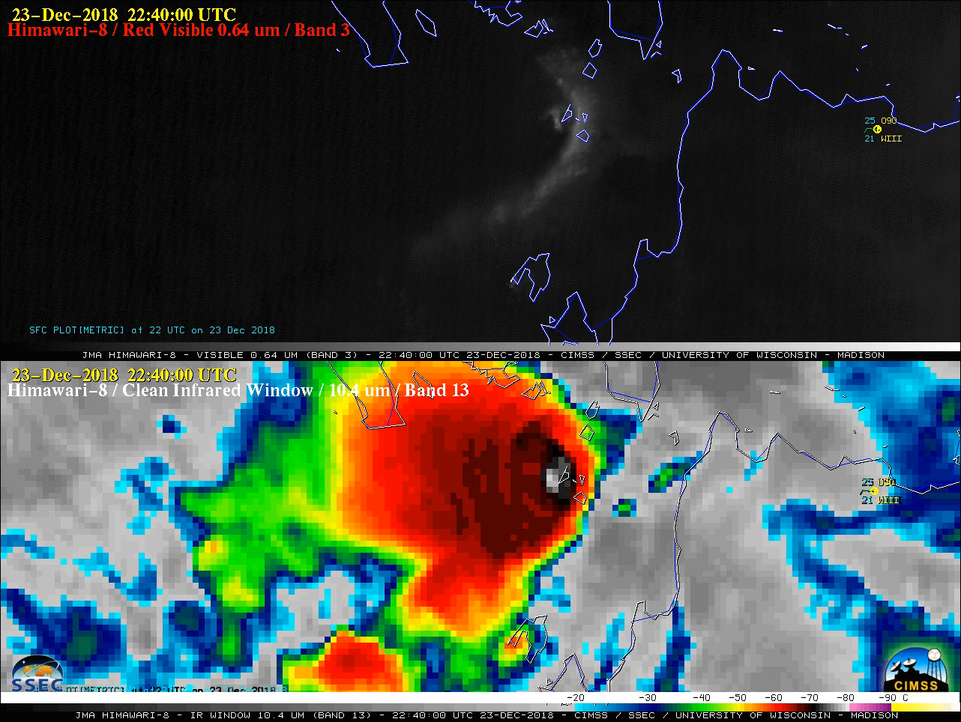
Volcanic CB Detection
From cims.ssec.wisc.edu, by Scott Machbeier,
A comparison of Himawari-8 Visible and Infrared images showed the persistent volcanic cloud following sunrise on 23 December (below). The pulsing overshooting tops continued to exhibit infrared brightness temperatures as cold as -80ºC at times
CSPP Users’ Group meeting, 2019

Slide 22
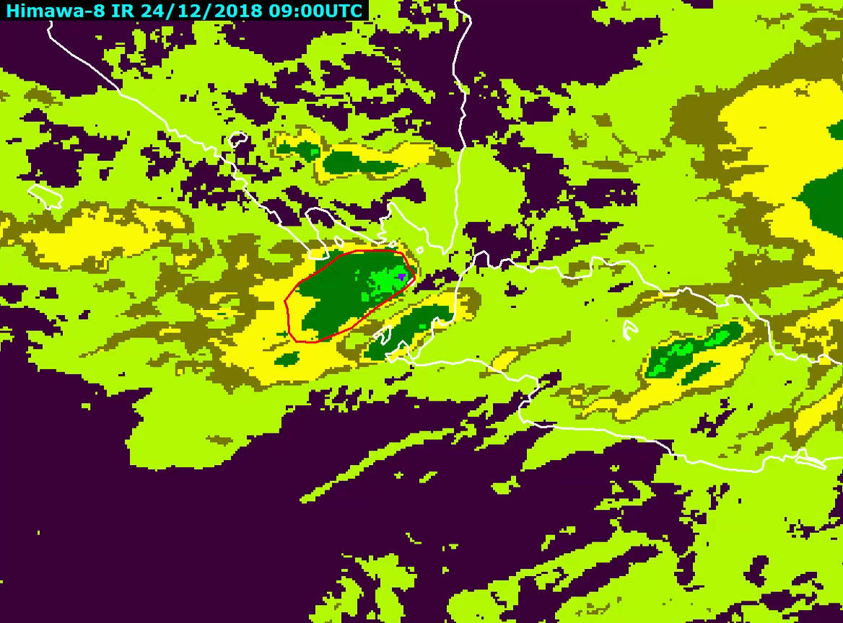
Volcanic CB Detection
Compared VC to other convective cloud, VC last longer, and tend to have same top temperature.
CSPP Users’ Group meeting, 2019

Slide 23
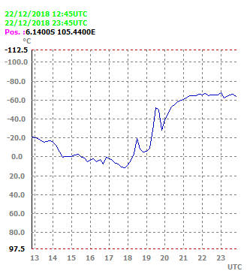
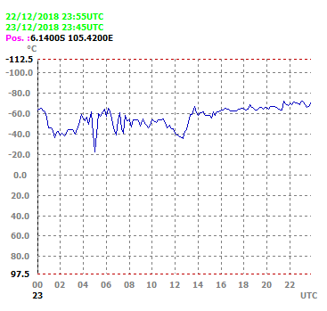
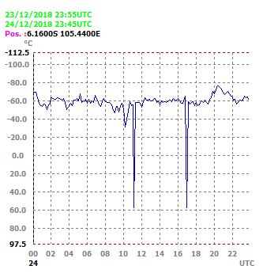
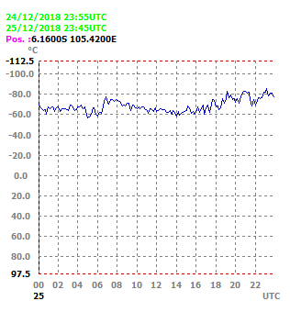
Volcanic activity (depicted from volcanic cloud top temperature) tend to increase at nighttime and decrease in the morning.
CSPP Users’ Group meeting, 2019

Slide 24
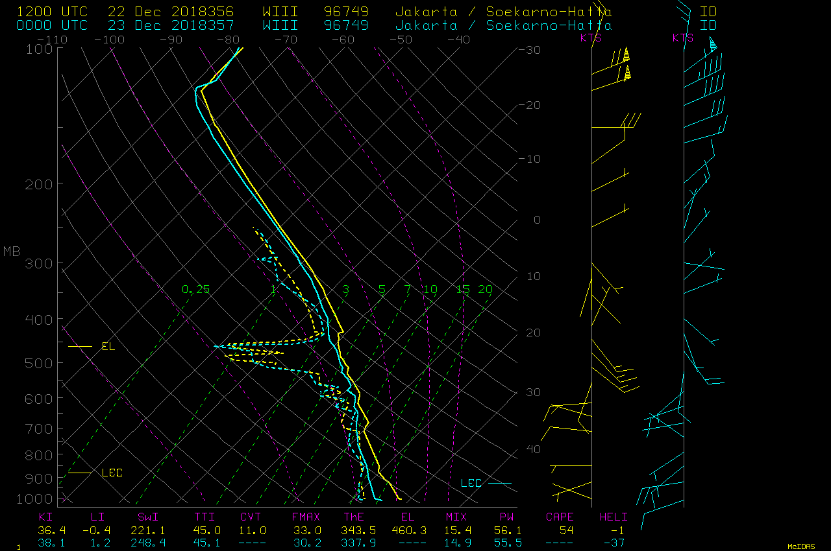
Radiosonde data from Soekarno Hatta station 22 dec 2018 :
-70 or colder, about 10 km or higher
CSPP Users’ Group meeting, 2019

Slide 25
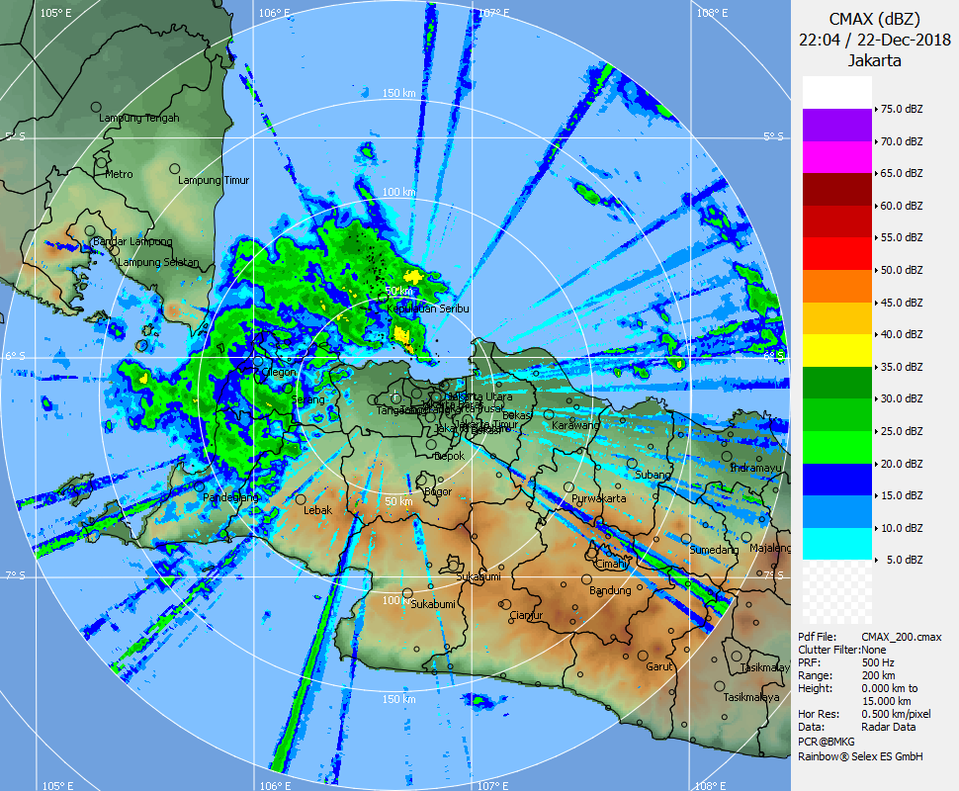
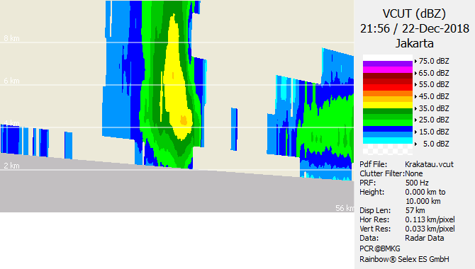
CMAX and VCUT from Cband Radar, located in Lampung about 100 km from Krakatau.
Prata (2019), presented at EGU 2019:
The eruptions generated an almost continuous convective cloud that was observed by a variety of earth orbiting sensors for ∼5 days. Using Himawari 8, he show that the eruption generated a large plume of SO2 gas streaming south-westwards at altitudes in excess of 15 km. Stereoscopic SLTSR data are used to determine the height of the high clouds and indicates that these reached the tropopause and possibly the lower stratosphere.
CSPP Users’ Group meeting, 2019

Slide 26
Conclusion
Krakatau eruption plume is rather different from other eruption plume. Instead of amount of volcanic ash, it emitted ash-poor, thick and cold volcanic cloud.
Volcanic cloud pattern can be recognized from its pattern through various RGB, and a caution of enhanced infrared analysis.
Convective volcanic cloud is last longer (depend on the volcano activity) than non-volcanic convective cloud, the highest CTT (overshoot top) steadily around the mountain while non-volcanic move, grow, and deceased fast.
CSPP Users’ Group meeting, 2019

Slide 27
Thank You For Your Attention!
CSPP Users’ Group meeting, 2019

